Slide 1

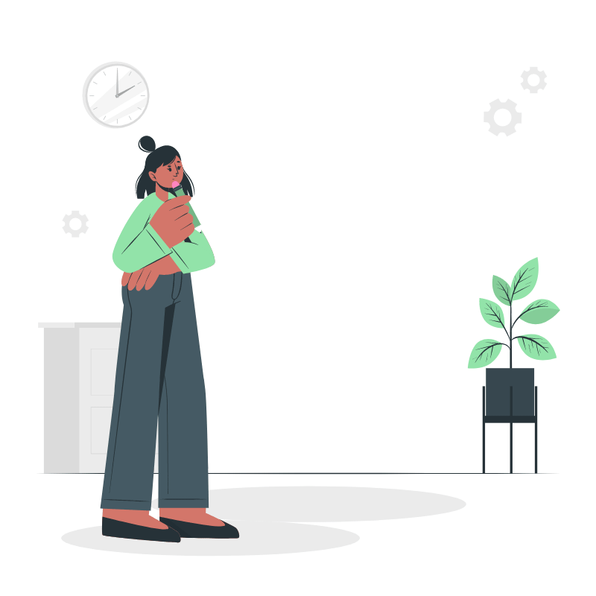
Riddle
r
By The Children of The Demogorgons
John, Julie, Xuan, Oleg, David & Donhem
Notes:
Everyone says their name and we introduce the problem statement, the order of the names is the order of the slides

Slide 2
User Journey
User Sign in/Sign up -> Settings -> Create Quiz -> Discover Page -> Play the game

Slide 3
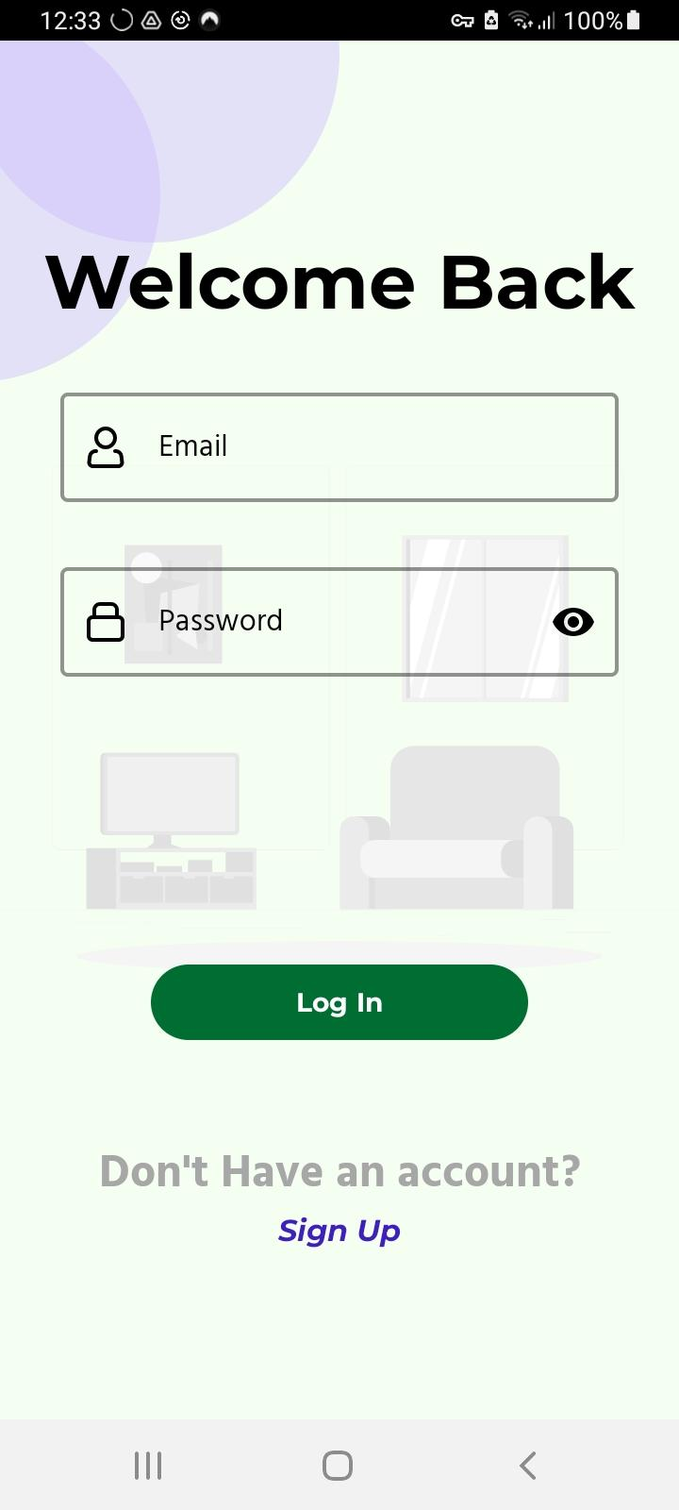
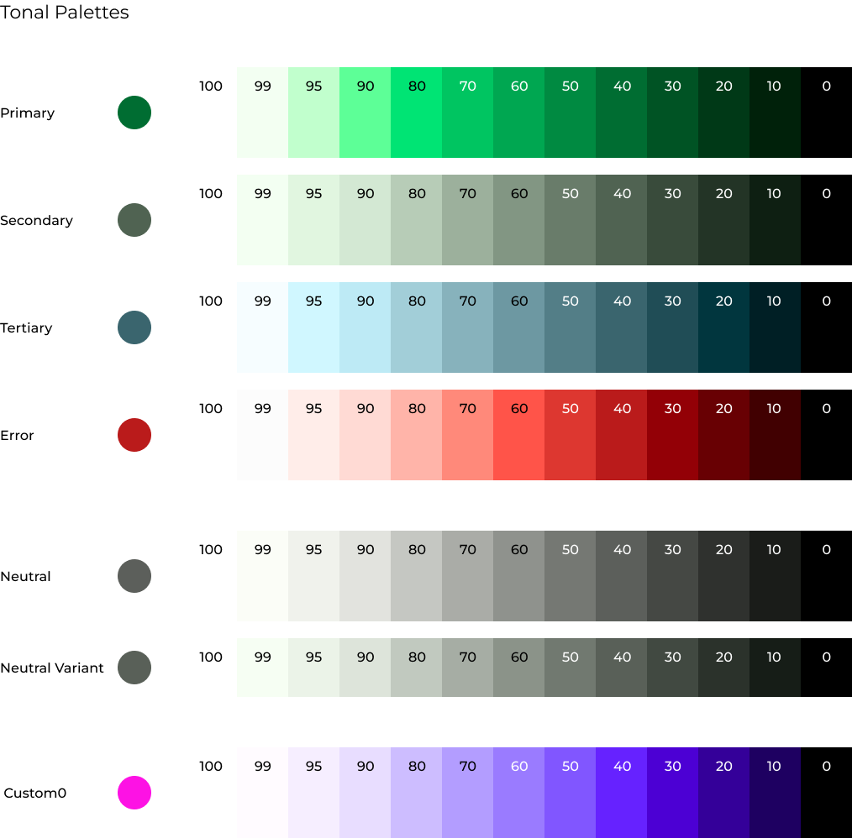
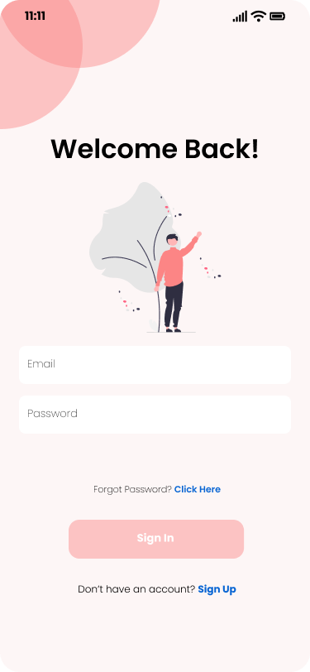
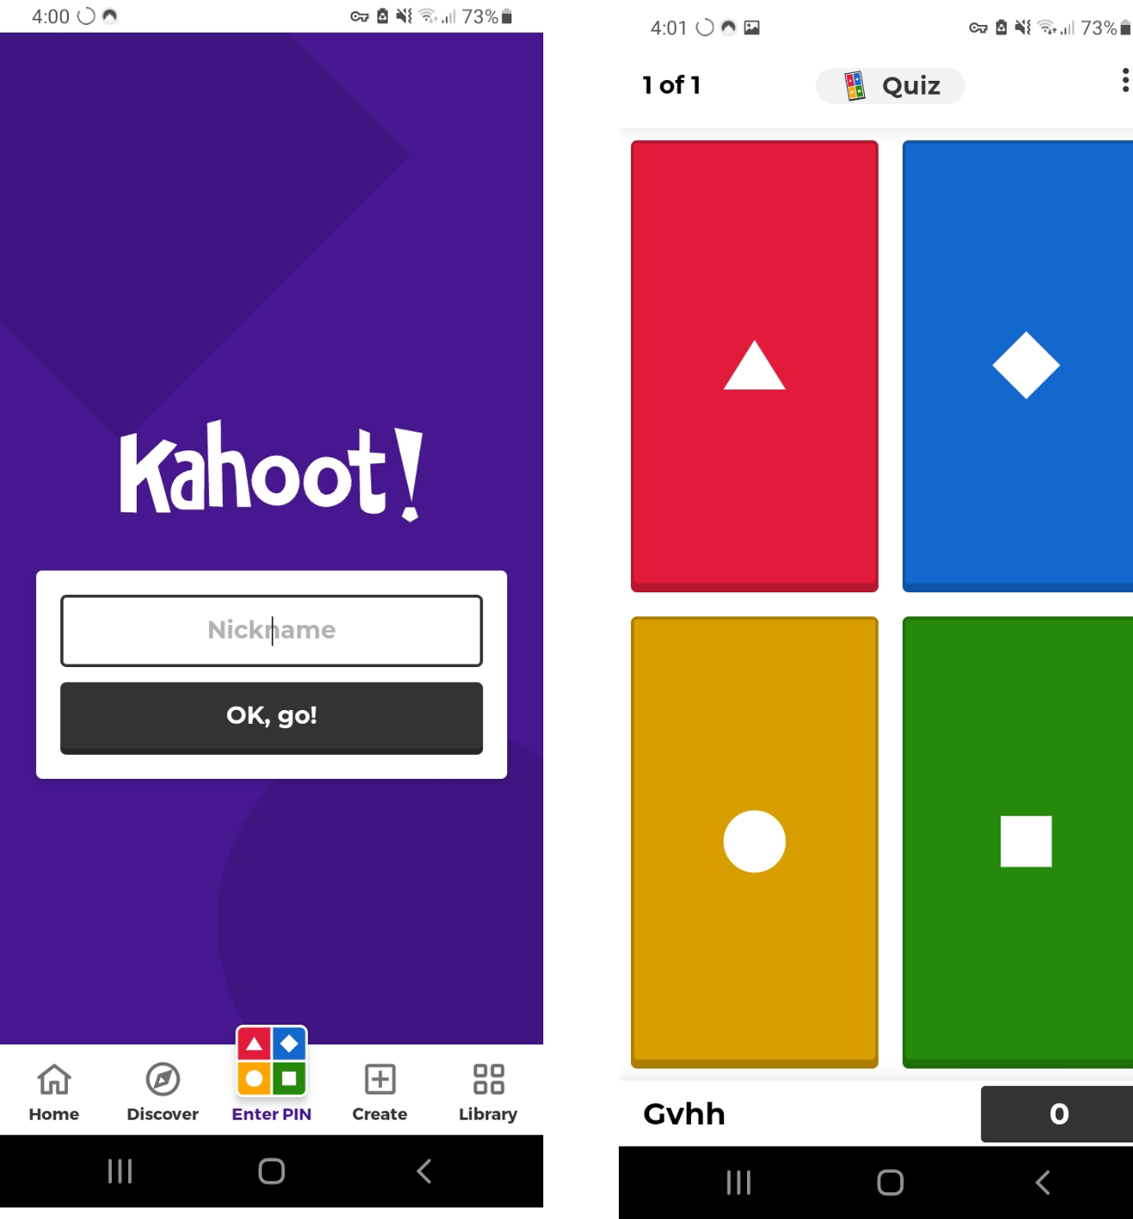
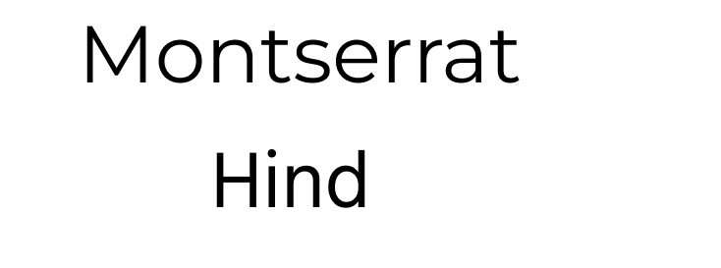
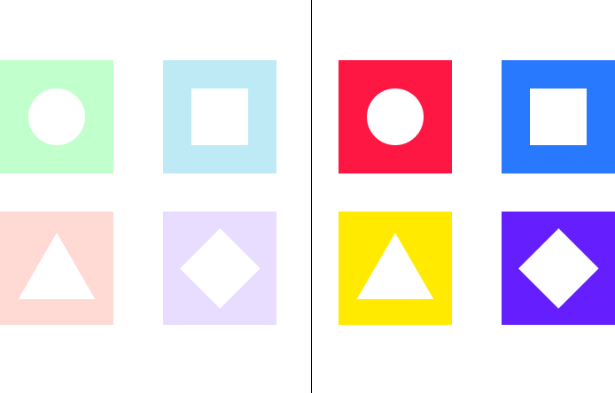
Styling
Final Product:
Color Palette:
Inspiration:
Typography:
Shapes:
Notes:
John

Slide 4
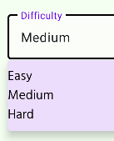
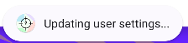
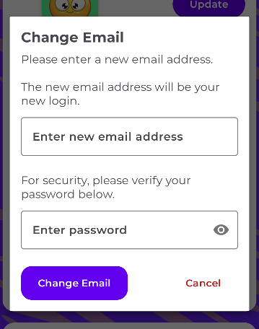
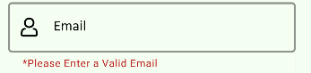
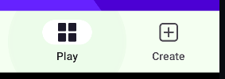
Responsive Design
Sliders
Toasts
Alert Dialogs
User Experience
Helper Text
Ripple Effect
Notes:
John Slide the settings section

Slide 5
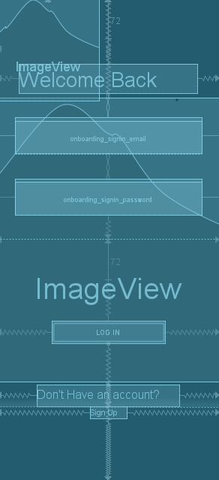
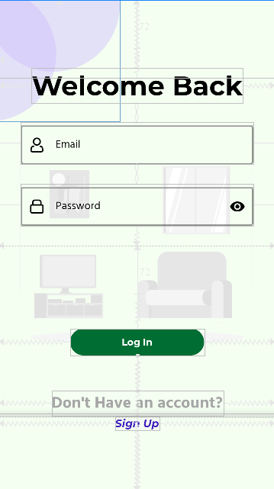
Constraints
A12
Pixel 4
Pixel 3
Adjustable Width
Barriers and Guidelines
Packed Chainstyle
Opposing Constraints
Notes:
John Slide

Slide 6
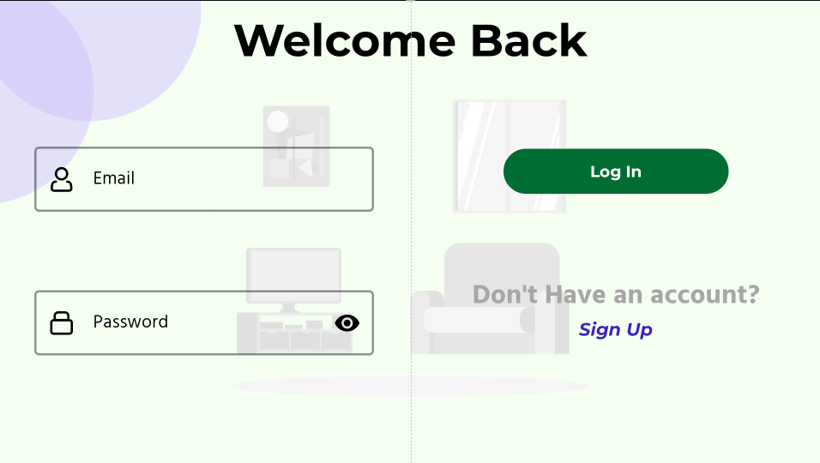
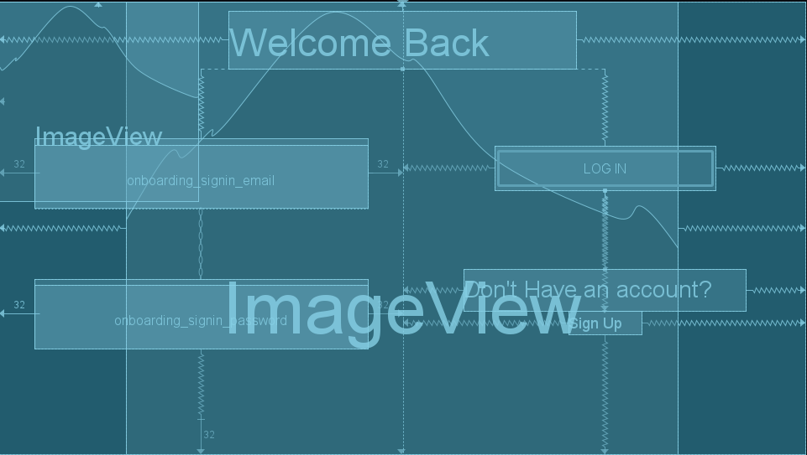
Landscape
New Guidelines
(X over Y)
Corner Constraints
Scalable Images (SVG)

Slide 7
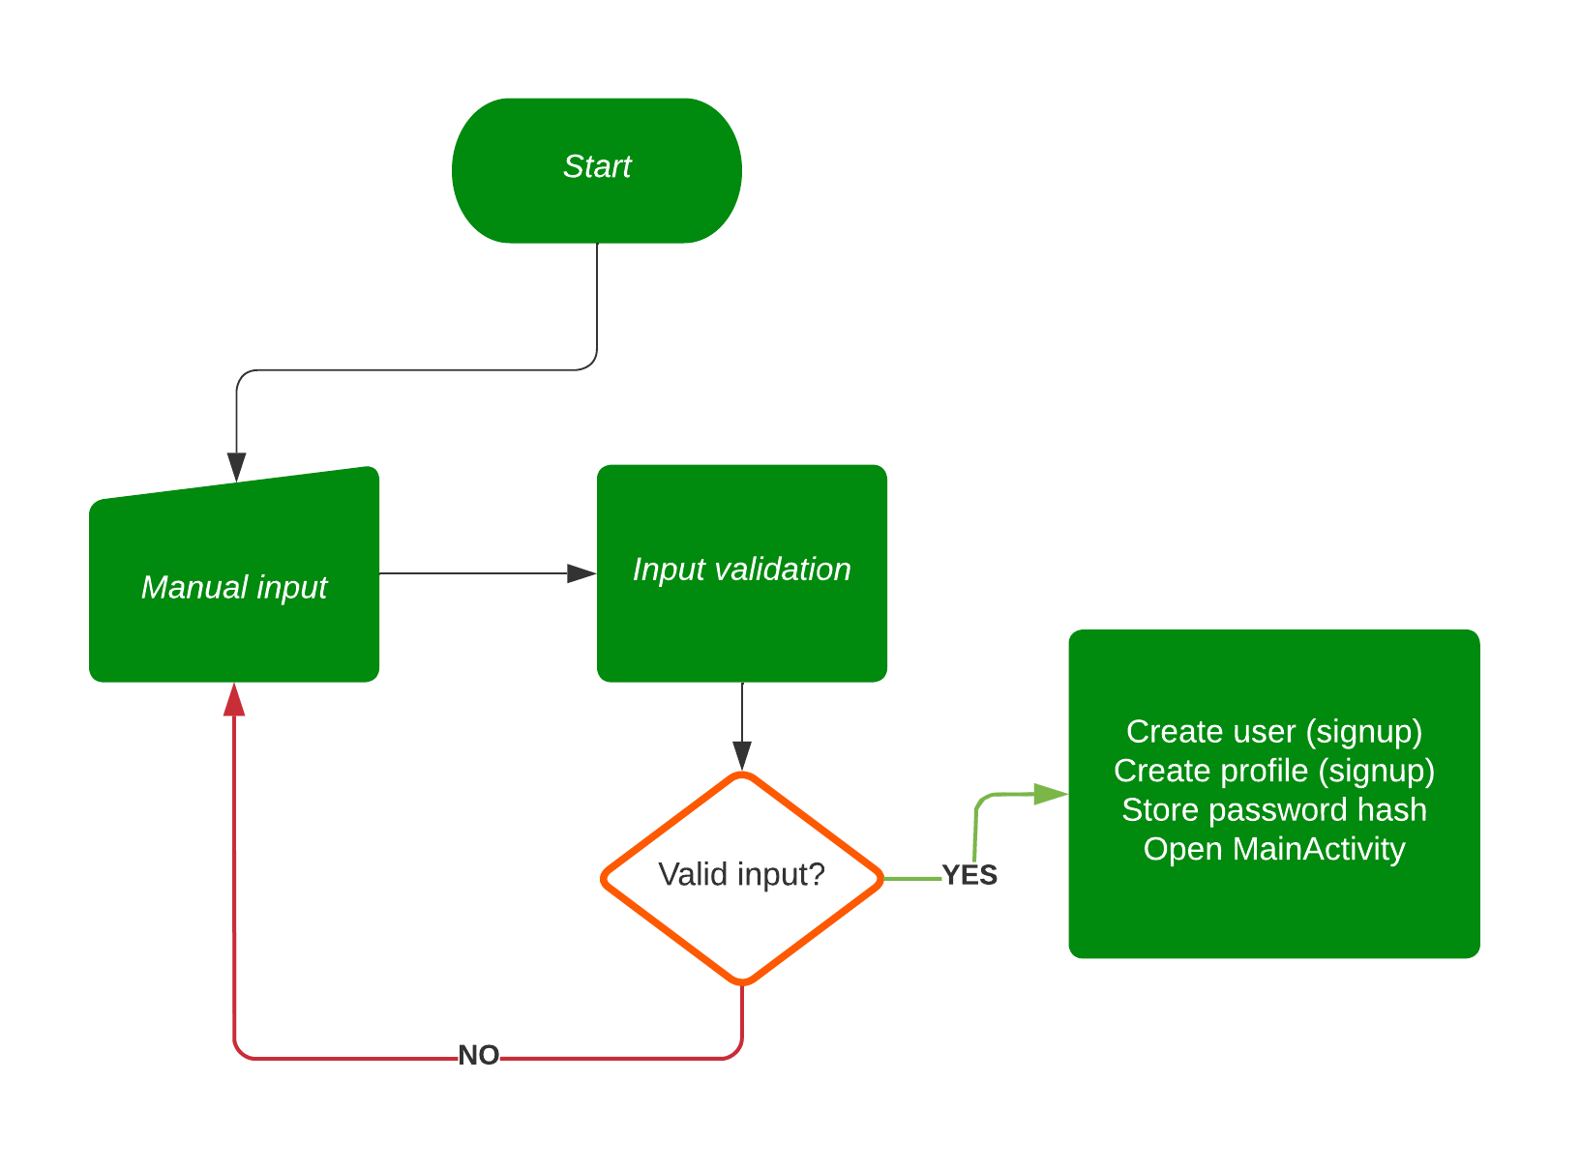
Firebase Auth
Notes:
For our backend, we chose to use Firebase Firestore, since it is free, easy to use, and it has offline storage enabled by default. Therefore, it seemed appropriate that we use Firebase for authentication as well; we originally wanted to incorporate Okta as an authentication provider, but we decided it is not necessary, since Firebase is an authentication provider as well. For this app, we chose to authenticate with user-provided email and password. The way the authentication works is as follows. After an appropriate fragment gets loaded, the user enters their email and password. The input is then validated. If the user is on the sign-up screen, the user account is created. Also, the user profile is created, which contains the user's first and last name, and their account picture, all of which can be later changed in the settings. In both the sign-in and sign-up cases, the entered password is stored in the preferences as an SHA-256 checksum, which is used to validate the password inside the change password and change email screens. Finally, the Main Activity is opened.

Slide 8
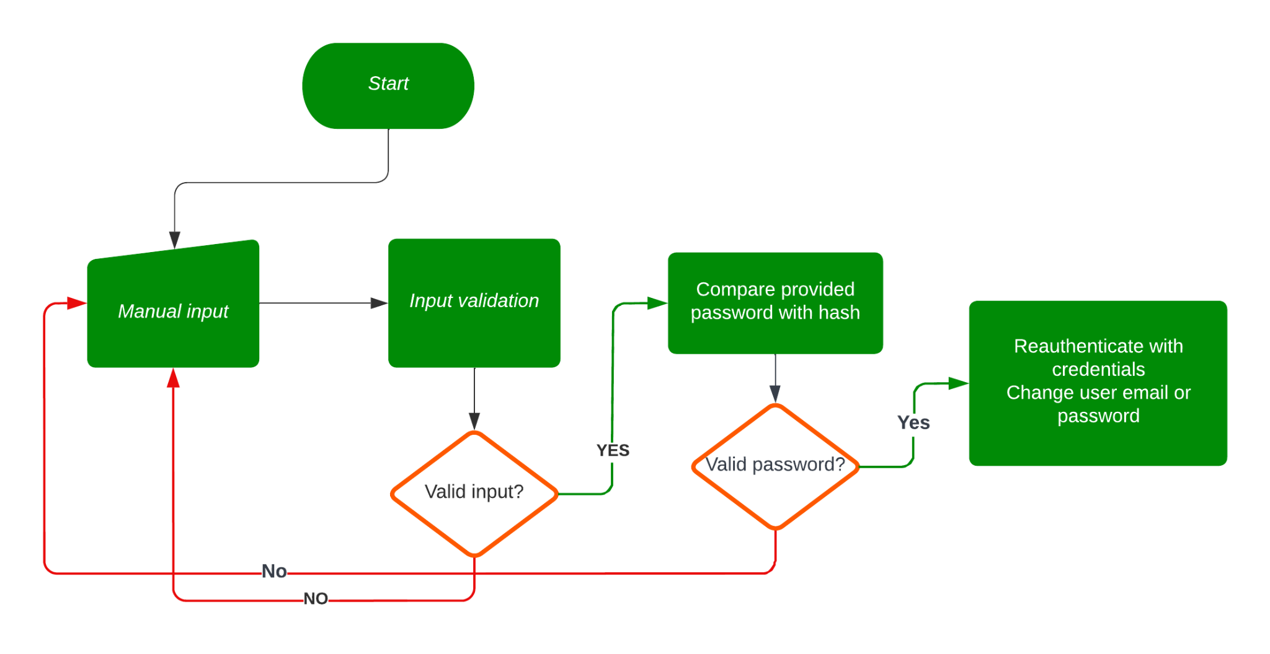
Firebase Auth
Notes:
The processes of changing user's email and password, both of which are used for authentication, are similar. First, the user enters their credentials, and they are input validated. Next, the password is checked against the stored hash. If the password matched, the temporary credentials are created, which are then being used to reauthenticate inside Firebase - this is a necessary step to make changes to the existing user credentials. Finally, the email or the password is changed, and the changes can be used next time the user tries to login to Riddler.

Slide 9
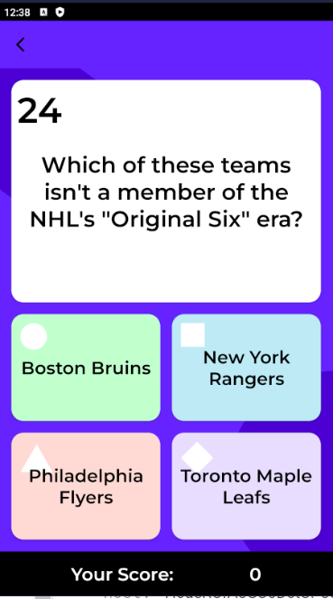
The Quiz
Host
Create Lobby
Start Quiz
Update Game State
Lobby
Game
Player
Join Lobby
Read Game State
Notes:
Xuan

Slide 10
Cloud Functions
App
Cloud Functions
Firestore
Manages updates
Read/write to firestore
Validates input
Performs logic
Stores game state
Displays game state

Slide 11
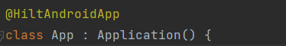
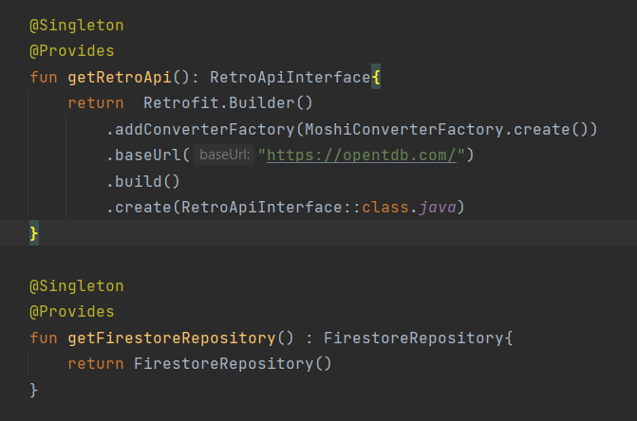
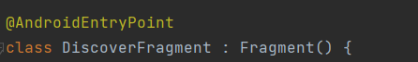
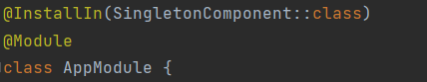
Dependency Injection
Notes:
Xuan

Slide 12
Retrofit API
No of Questions | Category | Difficulty | Type
10 | General Knowledge | Easy | Multiple Choice
12 | Books | Medium | Multiple Choice
14 | Film | Medium | Multiple Choice
16 | Mathematics | Hard | Multiple Choice
Notes:
Julie Slide

Slide 13
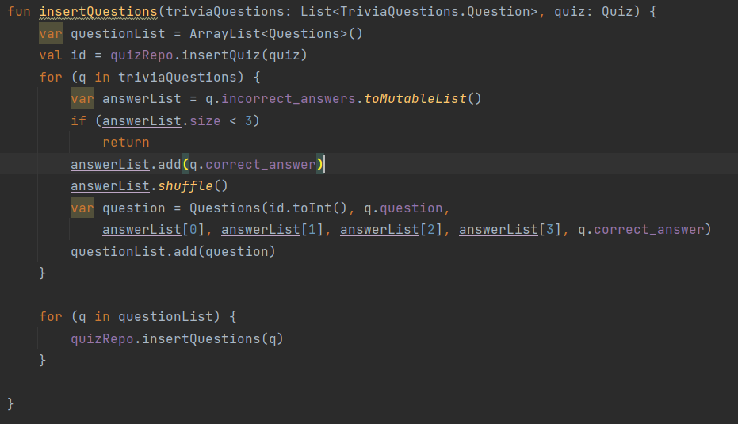
Local Storage
API Question
category
type
difficulty
question
correct_answer
incorrect_answers
DB Question
quizId
question
firstAnswer
secondAnswer
thirdAnswer
fourthAnswer
correctAnswer
id
Notes:
Julie

Slide 14

Localization
Languages we are Supporting:
English
Mandarin
Russian
Spanish
Notes:
Donhem

Slide 15

Sonarqube
No Bugs or Vulnerabilities
Reduced Code Smells
Reduced by creating more variables for reusability and deleting commented-out code and TODOs

Slide 16
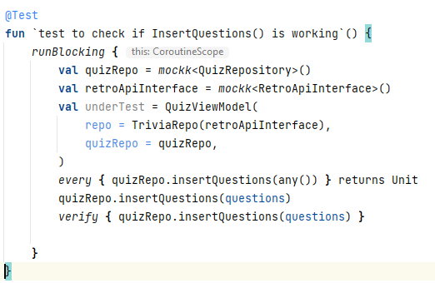
Testing - MockK
Support for Kotlin
Final classes
Object mocking/ ie static classes
Easily mock Extension functions
chain mocking

Slide 17
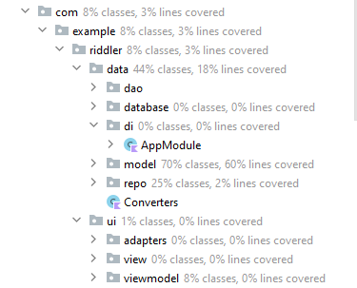
Testing - Coverage
Notes:
David

Slide 18
Thank you!
Any questions?

Slide 19
DES 7P
PRODUIT | PLACE | PRIX | PROMOTION | PERSONNES | PROCESSUS | PREUVE PHYSIQUE
Conception | Détail | Stratégie | Publicité | Fondateur | Accueil | Vitrine
Technologie | Grossiste | Cost-plus | Offres spéciales | Employés | Conseil | Uniforme
Ergonomie | Proximité | Cost leader | Cadeau | Culture | Horaires d’ouverture | Témoignage
Utilité | Export | Rendement | - | Service | Essais | Charte graphique

Slide 20
LISTE DES CONTENUS
DÉFINITIONS
MÉTHODOLOGIES
01
02
AUTEURS
ASSOCIATIONS
03
04
Vous pouvez décrire ici le sujet de la section
Vous pouvez décrire ici le sujet de la section
Vous pouvez décrire ici le sujet de la section
Vous pouvez décrire ici le sujet de la section

Slide 21
AUDIT DE MARQUE
VÉNUS
MARS
MERCURE
LA TERRE
SATURNE
NEPTUNE
Vénus est la deuxième planète à partir du Soleil
Elle a été nommée d'après un dieu romain
Mercure est la planète la plus proche du Soleil
La Terre est la planète où tous nous vivons
Elle est composée d'hydrogène et d'hélium
C’est la planète la plus éloignée du Soleil

Slide 22

01
DÉFINITIONS
Entrez un sous-titre ici si vous en avez besoin

Slide 23
SECTEURS DE L’ACTIVITÉ ÉCONOMIQUE
INDUSTRIE
SERVICES
PRODUITS
B2B
PUBLICITÉ
MARKETING
CONSOMMATEURS
Vénus est la deuxième planète à partir du Soleil
Saturne est une géante gazeuse avec des anneaux
Mercure est la planète la plus petite de toutes
Jupiter es la planète la plus grande de toutes

Slide 24

OUAH !
Mercure est la planète la plus proche du Soleil et la plus petite de tout le système solaire

Slide 25
INDICATEUR DE PERFORMANCE CLÉ
 | KPI 1 | KPI 2 | KPI 3 | KPI 4
Décrivez ici l'objectif
Décrivez ici l'objectif
Décrivez ici l'objectif

Slide 26
N'OUBLIEZ PAS
LISTE 1
LISTE 2
Une chose que vous ne devriez pas oublier
Une chose que vous ne devriez pas oublier
Une chose que vous ne devriez pas oublier
Une chose que vous ne devriez pas oublier
Une chose que vous ne devriez pas oublier
Une chose que vous ne devriez pas oublier
Une chose que vous ne devriez pas oublier
Une chose que vous ne devriez pas oublier

Slide 27
RESSOURCES ALTERNATIVES
Voici un assortiment de ressources alternatives dans le même style que ce modèle :
PHOTOS
Elevated view of businesspeople planning natural resources preservation in office
Smiling businesswoman giving presentation on world environment day to hr colleagues
Man working on project at desk
STORYSET
Startup life
Projections
Team
Businessman
Company
Good team
Telecommuting
Work time

Slide 28
NEW! Create a branded experience with Kahoot! themes
Avez-vous aimé leBoost audience engagement by customizing your kahoots for your work setting.e ce modèle ? Obtenez-les gratuitement sur nos autres sites Web :
PHOTOS
Medium shot men working on project
Group of businesspeople discussing on natural resources preservation in office
Group of businesspeople looking at natural resources icon in meeting
STORYSET
Growing
In the office
Bowser stats
Business deal
Rising
Visual data
Connected
Market launch

Slide 29
Fonts & colors used
This presentation has been made using the following fonts:
Fjalla One
(https://fonts.google.com/specimen/Fjalla+One)
Open Sans
(https://fonts.google.com/specimen/Open+Sans)
#263238
#f5f5f5
#92e3a9
#c8f1d4
#455a64

